Slide 1


DISASTER MANAGEMENT SYSTEM
PRESENTED BY
2303811710422131-ROHINI D
SUPERVISOR
Mr.A.Malarmannan,M.E.,AP/CSE

Slide 2

PRESENTATION OVERVIEW
Objective
Project Introduction
Problem Statement
Methodologies (Programming concepts relevant to problem statement)
Architecture of the proposed system
List of Modules
7. Merits
8. Results and Discussion
9. Queries

Slide 3
OBJECTIVE
A disaster management system includes preparedness and prevention, which involve planning, training, and risk mitigation to minimize disaster impact. It also includes response and recovery, focusing on immediate rescue efforts, relief distribution, and rebuilding affected areas. These objects work together to reduce risks and ensure swift recovery from disasters.

Slide 4
PROJECT INTRODUCTION
1. Purpose: To create a system that effectively manages disasters by reducing their impact and ensuring efficient recovery.
2. Focus Areas: Emphasizes preparedness, prevention, real-time response, and recovery efforts.
3. Technology Integration: Uses advanced tools and technologies for monitoring, early warning, and coordination.
4. Goal: To enhance community resilience and ensure a swift return to normalcy after disasters.

Slide 5
PROBLEM STATEMENT
1. Inadequate preparedness and delayed response lead to significant loss of life, property, and resources during disasters.
2. Lack of effective communication, early warning systems, and coordination exacerbates disaster impacts.
3. The project aims to create a system to improve readiness, ensure timely response, and facilitate efficient recovery.

Slide 6
i
Methodologies (Programming concepts relevant to problem statement)
Data Collection and Processing:
Use of APIs and web scraping to gather real-time data (e.g., weather updates, seismic activity).
Automation and Alerts:
Conditional statements and event-driven programming to trigger alerts based on predefined thresholds (e.g., earthquake magnitude).
Database Management: CRUD operations to manage data efficiently.

Slide 7
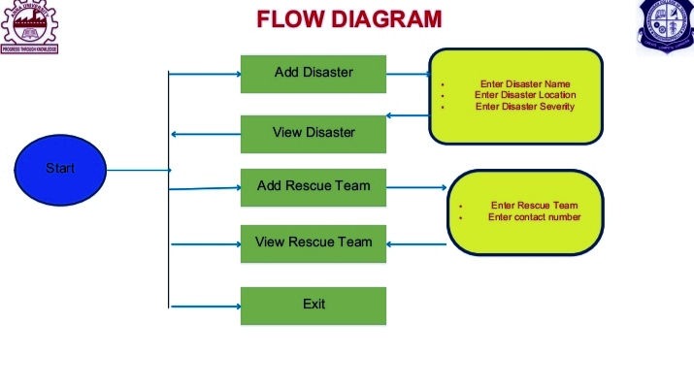
FLOW DIAGRAM

Slide 8
MODULE DESCRIPTION
Add disaster:The disaster management system uses programming concepts like data collection, automation, geolocation, and machine learning to monitor, predict, and respond to disasters effectively. It ensures real-time alerts, efficient data management, and user-friendly interfaces for quick decision-making.
View disaster :Disasters are sudden, catastrophic events causing significant harm to life, property, and the environment. Effective disaster management involves preparedness, real-time response, and recovery to mitigate their impact.
Add rescue team:Rescue teams play a critical role in disaster management by conducting search, rescue, and relief operations to save lives and minimize damage.
View rescue team:A rescue team is a specialized group trained to respond swiftly in emergencies, providing aid, saving lives, and ensuring safety during disasters.
Exit

Slide 9
MERITS
1. Minimized Losses: Efficient disaster management reduces loss of life, property, and resources through timely alerts and effective response strategies.
2. Enhanced Preparedness: Promotes readiness and resilience by implementing preventive measures and training programs for communities.
3. Improved Coordination: Ensures seamless collaboration between rescue teams, authorities, and technology for faster and more organized recovery efforts.

Slide 10
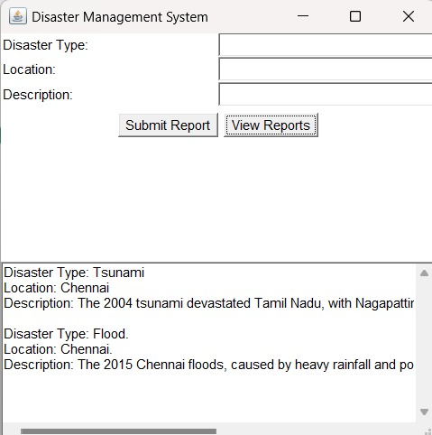
RESULT AND DISCUSSION

Slide 11
ANY QUERIES ?

Slide 12
THANK YOU

